Slide 1
Welcome to the GED® Tuesdays for Teachers Webinar
The webinar will start at 3:30 p.m. (EDT), 12:30 p.m. (PDT).
If you have a technical question, please type it into the question panel.
When you log on, check your audio to make sure your headphones are working properly. If you use your phone to call in, be sure to enter the appropriate codes.
If you do not hear anything during your audio test, look on the dashboard. Open the “audio” tab and select the option you prefer.
You will not hear the presenters until 3:30 p.m. when the webinar goes live.
Check the chat box to see any messages from the presenters.
Thank you for joining us today.

Slide 2
Increase Student Scores and Engagement:
GED Play and GED Flash
A Tuesdays for Teachers Webinar
by the GED Testing Service®
^{June 15, 2021}

Slide 3
Debi Faucette
Senior Director
Karyn Crowe Ruiz
GED Instructor
Tulare Adult School

Slide 4
In this session, we will…
Explore ways to keep students engaged in multiple instruction models
Discuss ways to increase student engagement and student outcomes in multiple instruction models
Take a “deep dive” into resources that can be used in multiple instruction models
Notes:
Key Points

Slide 5
The New Normal: Virtual Face to Face Hybrid/Blended
Notes:
Key Points

Slide 6
GED Programs Have Expressed a Need For:
Engaging distance learning tools
High quality content to supplement existing instruction
Ability to track student time on task

Slide 7
Correctional Programs Have Additional Needs:
Content that can be served offline
Instruction for students in restricted areas
Teacher support given widely varying levels of students

Slide 8
To address these needs, we’ve launched an instructional video program designed by Kaplan experts to enhance student performance on key GED measured skills.

Slide 9
Extensive Content
Targeted Lessons
Hours of video instruction covering all four GED test subjects.
Concepts align directly with the skills being evaluated on the GED test.
Top-Rated Instructors
Easy to Digest
Pre-recorded videos featuring experts at Kaplan.
Short, bite-sized lessons make sure students do not feel overwhelmed.

Slide 10
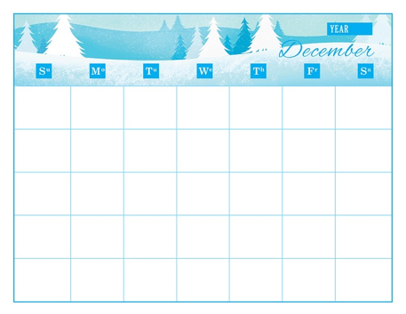
It’s All in the Planning
Set up your schedule
Decide what to teach
Determine how you will teach it
Find resources necessary to teach it

Slide 11
Set the Schedule
All remote?
All in person?
Blended version
What’s the Same?
What’s Different?
Simplify and Slow Down

Slide 12
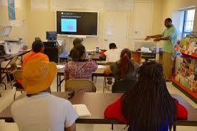
Determine How You Will Deliver the Instruction?
Identify Resources!

Slide 13
Notes:
Debi to discuss history of the partnership—discussions were begun when instruction was mainly F2F
Discuss what teachers and student’s were asking for—and GEDTS’ efforts to partner with a publisher to deliver on what they were asking for
GED Flash was launched, has been successful---and has been in use long enough to research its efficacy, which we will discuss a bit later
Important point is that it can serve students who seek instruction in all three of the instructional models we discussed earlier
We were pleased last year to have a guest educator share with you the very practical way to use Flash in the classroom
Today we are happy to take you on a “deep dive” into another resource, GEDPlay, which can be used in all instruction models, but can be especially helpful for your distance learners.
***I can transition to Karyn to pick up here, or if you want me to go into the GEDTS slides we use for Play I can do that, THEN hand over to Karyn
OR
***If you prefer not to use the slides on Play (

Slide 14
When and How
Students Are Placed
in GED Flash and Play
Notes:
I’m going to start by reviewing how my students are placed in the GED Flash and Play classes. Please keep in mind that Aztec offers many different academic programs and GED Flash and Play are available in different formats. I’ve included screenshots in this webinar of the version of GED Flash and Play that I have available through my instructional site. These features or functions might not be the same as to what you have available at your site. Please reach out to your Field Service Representative or Sales Rep if there is something that you’d like to learn about.

Slide 15
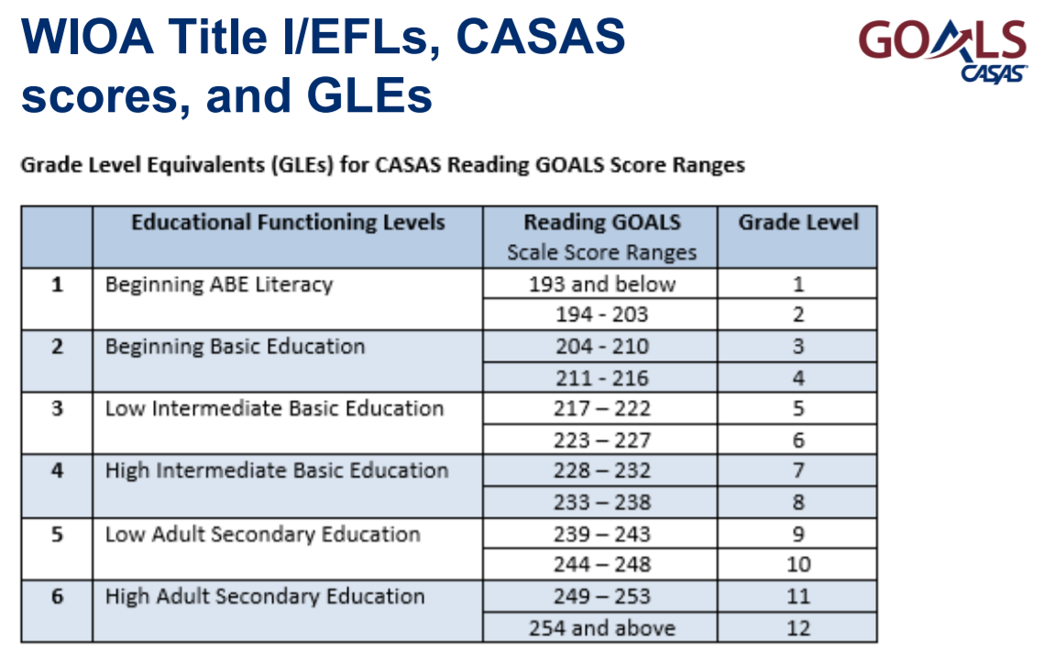
Class Placement
Notes:
I’m going to start with a little background info about my site. At my school, students are placed in my GED class based on their State-Approved NRS entry exam.
We use CASAS on our site so my students need to score a 239 on the C or D level Reading test which shows that they are functioning at a high school grade level in reading.

Slide 16
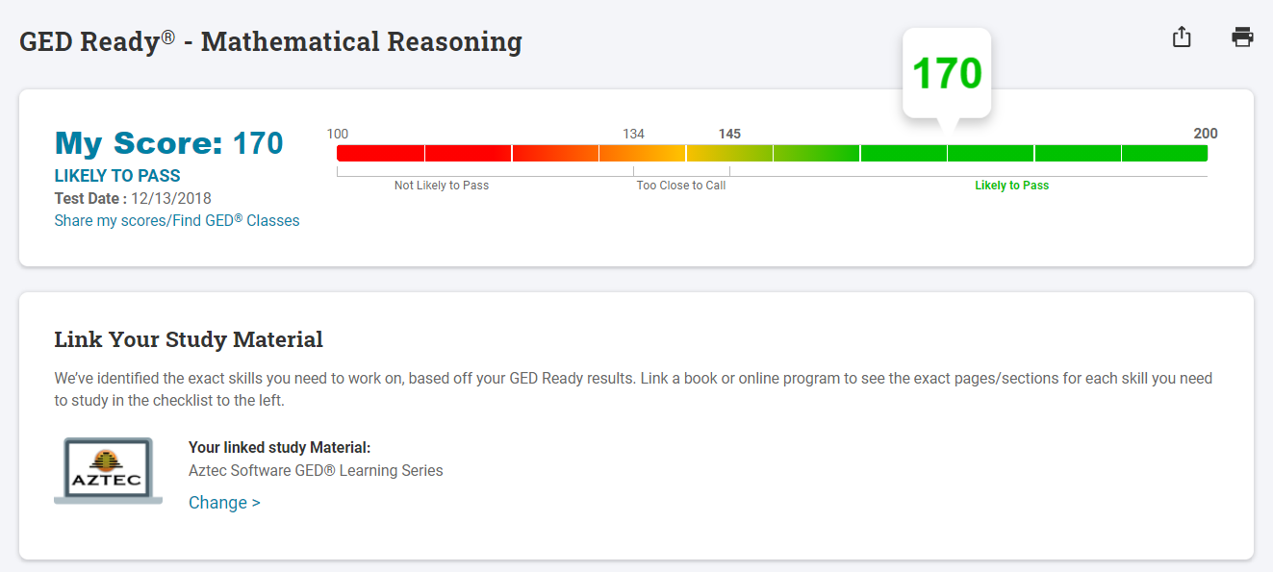
GED REady
Notes:
One of the first things students do when they enter our GED classes is take a GED Ready Practice Test. I usually suggest students take a GED Social Studies or Math test. Reading comprehension is important in all content areas, but the Reasoning Through Language Arts (RLA) also incorporates grammar, syntax, and the essay. The Social Studies test can provide some insight into the reading ability without the pressure some students feel to address grammar and the written essay at the start.
The social studies is primarily reading comprehension whereas the Language Arts has reading comprehension, some grammar and syntax, and an essay (which, I believe is not graded).
Some students, and in my class we call them “unicorns”, like to start with math or science. I suggest that they take the math practice test first since there is a little algebra in the science and it helps to know what their math skills are before we try to tackle the science content.

Slide 17
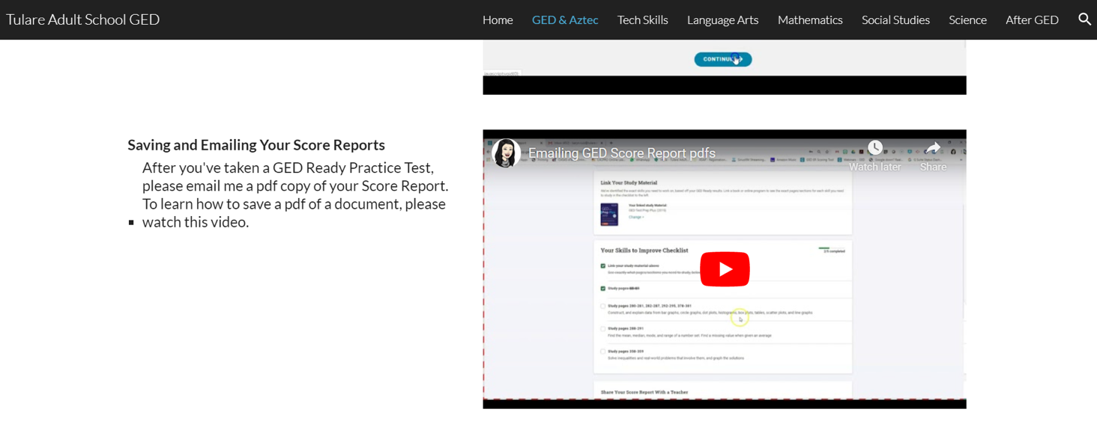
GED Ready Scores
Notes:
After they take their GED tests, we review their score and their score reports. Usually this takes place in my classroom, but, since my students are working from home, I have them email a pdf of their scores to me. This was a step we struggled with last spring. So I created a video for our class website that explains how to run the report for the Kaplan GED book, for Aztec, and for the Paxen GED books. These are all resources that I have available to me and my students on our campus. The students then need to save those documents as pdfs on their computer and then attach those pdfs in emails to me. We discuss how this is a great skill for them to have for the future if they need to save and attach documents to emails. We also talk about how the report describes what skills the student needs to work on and how that information helps me develop an individualized learning plan for them that only includes the skills that are pertinent to their passing the test. I explain that this is the reason I need the whole report and not just their score.

Slide 18
GED Ready Scores
Not Likely to Pass – Aztec coursework, textbooks
Too Close to Call – Aztec coursework, textbooks
Likely to Pass
150+ – GED Flash and/or Play
145-150 – GED Flash/Play or lessons from the Score Report
Notes:
When I get a student’s score reports, I first look at the score bar at the top of the report.
If I have a student whose score is in the not likely to pass range, they start working on Aztec or, if they don’t have access to technology, one of our pre-GED Textbooks. When they get into Aztec, I have them take the Locator tests to determine which classes to place them in.
Students who are in the too close to call range also start working on Aztec or our GED textbooks. Even though their scores may be very close to the passing score of 145, the Aztec Learning System software’s pre-learning assessments will identify skills in which the student has already shown competency and allow the student to bypass those lessons and or drills. In my class, the students can bypass any waived lessons but they need to complete all of the drills with a minimum score of 80%.
In my class, I most often assign GED Flash for those students whose GED Ready Practice test scores are in the likely to pass range
I suggest that my students score at least a 150 or higher before scheduling to take an actual GED test. Some of the students schedule to test soon after taking the practice test while others decide to do a little studying before testing. Either way, I enroll these students into GED Flash until they take their official GED test.
If their score is between a 145 and 150, the student and I usually talk about what they would like to do. Some students want to work with GED Flash and others want to review the lessons outlined in the GED Ready Score Report. I do have some students who want to take the GED test as soon as their Ready Practice Test score hits 145. However, after prepping for this webinar and getting a sneak peek at the data my co-presenters are going to share with you, I have a new bit of evidence to share with these students that supports their taking a little time to work on GED Flash to bump their score up to 150 or higher. The other presenters will go into this with us in a little more detail, but I will be sharing with my students that there has been research done to show that students who complete at least 10 rounds of GED Flash sets are likely to increase the GED Ready Practice Test score by 4 points.

Slide 19
GED PLAY: when should it be implemented
Direct Instruction
Before Instruction – Anticipatory Set (in class or as homework)
After Direct Instruction – Post-Instruction review (in class or as homework)
Remote Instruction
Anticipatory Set
Post-Instruction
Gap Filler
Review
Refresh
Notes:
GED Play can be integrated into instruction in a variety of different ways.
With direct instruction lessons, it can be used as
an anticipatory set activity to activate your students’ prior knowledge and prepare them for learning. This can take place either in class or as homework the day prior to the lesson’s presentation as part of a “flipped lesson”. Play videos can also be assigned
after lessons have been presented, either in class or as homework.
With remote instruction, either synchronous or asynchronous, Play videos can still be a part of
an anticipatory set or
post-instruction activity. I’ve most frequently used them as
gap fillers for students to
review or
refresh skills, concepts, and vocabulary. However, I will be working this summer to really review the content of the Play videos and see which lessons they align to within the Aztec Learning classes.

Slide 20
The Student View of GED Flash
Notes:
Before we start reviewing the student view of GED Flash, are there any questions about the previous slides and what parameters are considered with student placement in the GED Flash program?

Slide 21
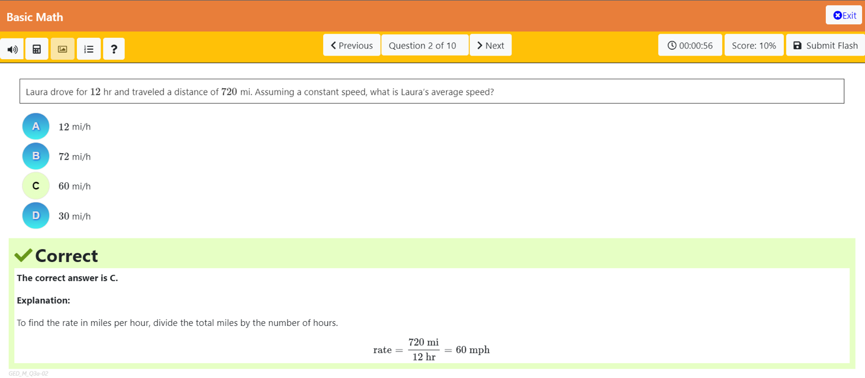
GED Flash Question
Notes:
When my students get started in GED Flash, I explain the following to them -
There are 10 questions in each Flash set. They can move forward and backward through the questions if they want to.
There is a timer but there is no time limit. For students who are scoring low on their sets, we review the time they’ve spent on each set and try to determine if maybe they need to spend more time on each question. For students who are scoring 80% or higher on their sets, we review the time to see if they need to shave a little time off of their work.
For my students who scored between 145 and 150 on their GED Ready Practice test, I explain that we want their scores in their Flash Sets to be consistently at an 80% or higher before they take another Practice Test. I describe consistently as being 2 or 3 times in a row.
I explain to my students that if they click Exit, they’ll return to the Flash menu but their scores won’t be tabulated.
They need to click Submit Flash in order for their scores to be included in the score report on the Flash Menu. We’ll talk about that in a second.
Just a few more things here – I let my students know that the question is usually in a white box. For subjects other than math, there are often sections of text that are included in a Flash question and they are usually in a yellow box and often the student will need to drag the contents up and down in the box to view the entire piece.
I do let my students know that, for multiple choice responses, whatever answer they click on the first time is their submitted answer. I had a student who got frustrated with that because she liked to click on each letter as she read them and we had to retrain her to click in front of the letter.
The last and most important part for the student, aside from the question, is the pop-up answer. This slide shows an answer that is correct but there’s always an explanation of why the answer is correct. So I instruct my students to read all of the explanations – whether or not they answered the question correctly. I explain that I often can answer a question correctly but maybe for all the wrong reasons – or that there may be new information in the explanation that I should jot down in my notes.
And a final bit for the teacher – if there are any questions about the Flash question, each one is numbered and I love that I can send the number and my question to my field service representative and he can either answer my question or forward it on to tech or curriculum support.

Slide 22
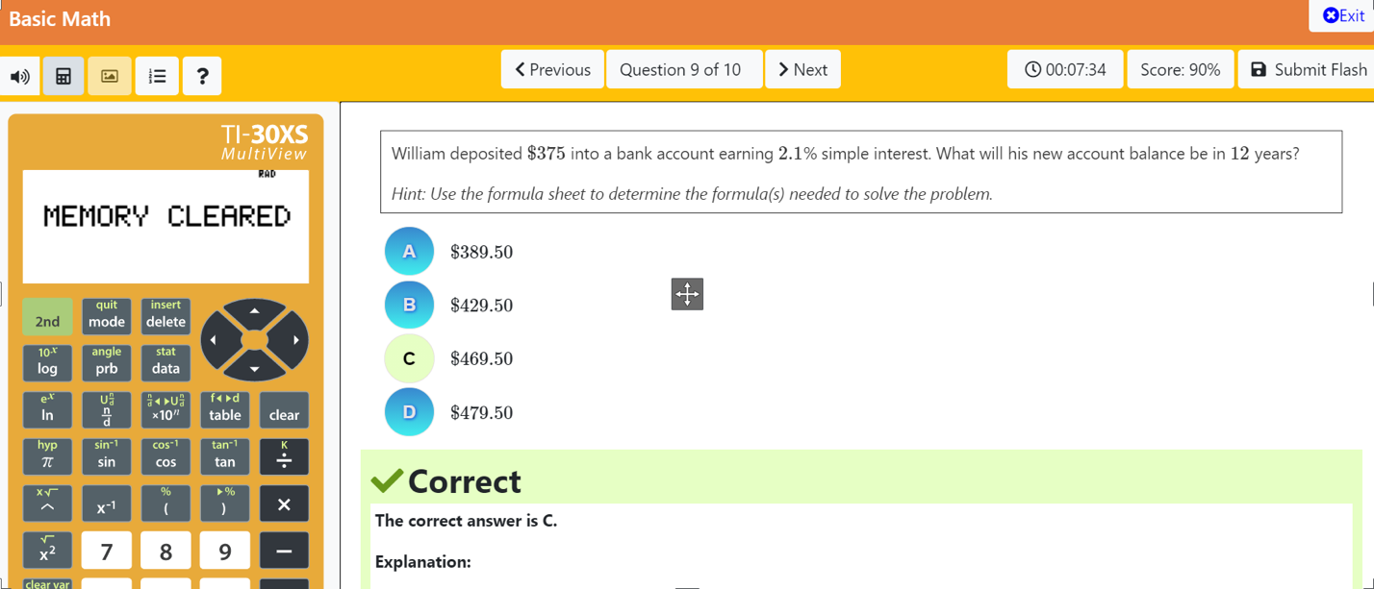
GED Flash screen
Notes:
A couple other things to note –
There is a calculator available that is the same as the TI-30xs that students can use during a GED test.
Students can also click on the picture icon to open the formula sheet (and you can see that there is a hint in the question box guiding the student to open the formula sheet).

Slide 23
Submitting a completed set for scoring
Notes:
When the student submits their last answer
There’s confetti and a loud celebration, depending on your speakers. You might want to give your students a head’s up. You can let them know that I, as a modestly experienced teacher, shrieked loudly in an empty room when it went off the first time which caused my neighboring colleagues to come check on me.
After they finish, they’ll want to click on Submit Flash. When the do, they’ll be taken back to the GED Flash Classroom Home page.

Slide 24
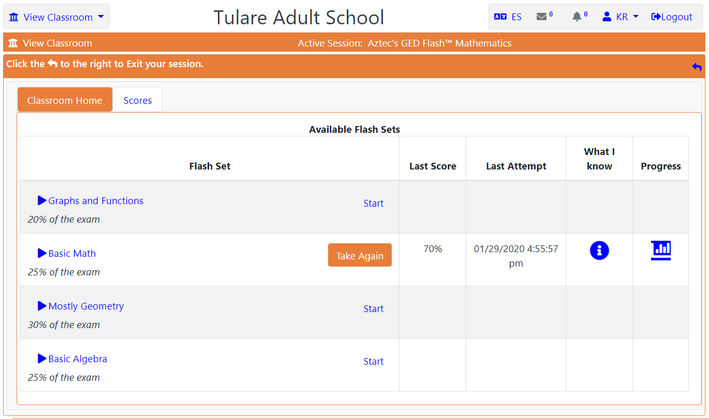
GED Flash home page
Notes:
In the classroom page, the “What I Know” and “Progress” icons will appear after a student completes and submits one flash set. students can click on them for information about their progress.
We’ll look at the What I know part first.
Before we move forward though, I want to you notice that there are 4 different groups of Flash Sets for Math. The sets are based on the content in the GED and you can see the percentage of the test each group covers. The other subject area Flash sets are organized and detailed in the same manner. So if you were to click on the I icon in the what I know column . . .

Slide 25
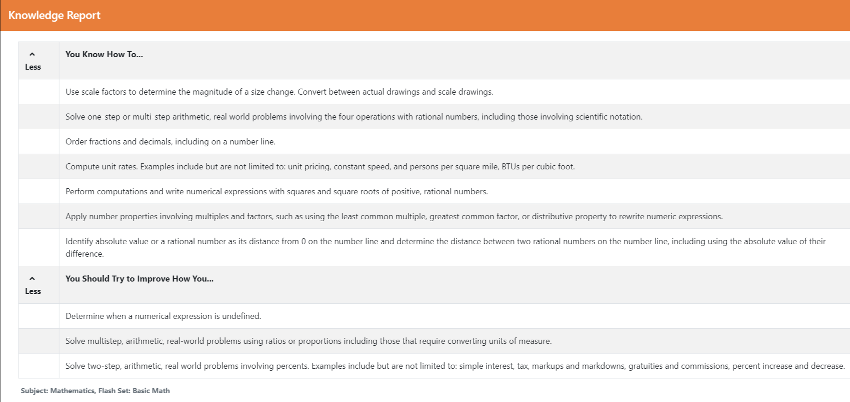
GED Flash Knowledge report
Notes:
This will open up the Knowledge Report.
It’s broken into two different sections – “You know how to” dot dot dot and “You Should Try to Improve How You” dot dot dot.
This is a great report for students to review regularly and also for instructors to review with them, particularly if students had scored in that 145-150 range.
What I’ll have students in this range do is complete 5 rounds of Flash in the same set and then we’ll review the “You Should Try To Improve” areas and discuss them – Does the student need some additional lessons or practice in these areas or maybe just a little review with me.
You can see here that this student (who’s actually me) needs to work with undefined numerical expressions and multistep real world measurement problems that use ratios, proportions and percentages. Remediation can occur after just one completed set of Flash but the student will have only seen one card in each of the skill areas shown above. Note that my Knowledge Report only includes my completion of one Flash set. This means that each skill is only assessed once per each Flash set. So completion of multiple Flash Sets is needed to get a clear picture as to what skills the student does or does not need remediated.

Slide 26
GED Flash home page
Notes:
Let’s look at the “Progress” icon
When clicked, this window will show up

Slide 27
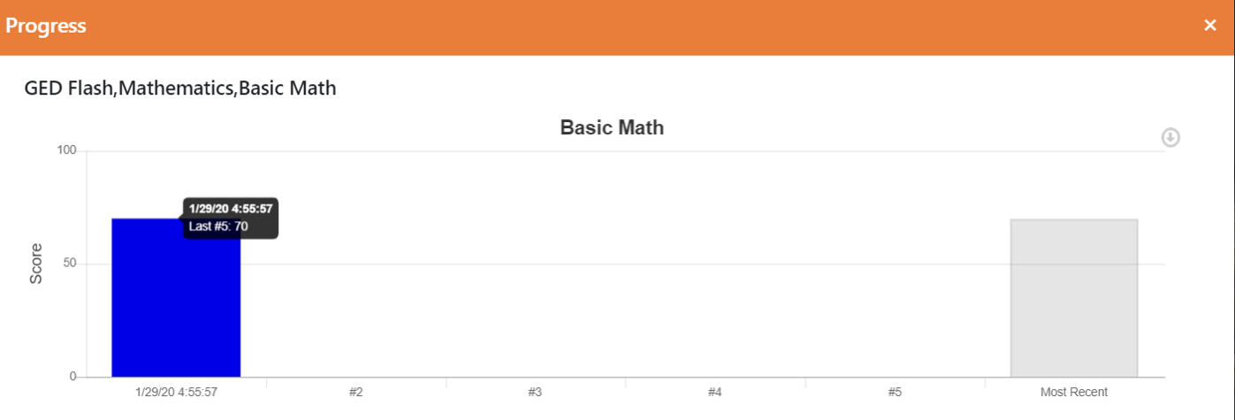
GED Flash Progress Report
Notes:
To show when the student had taken the test and what the score was. The blanks show attempts that have not been completed or submitted.

Slide 28
GED Flash home page
Notes:
The student can also click on the SCORES tab
And

Slide 29
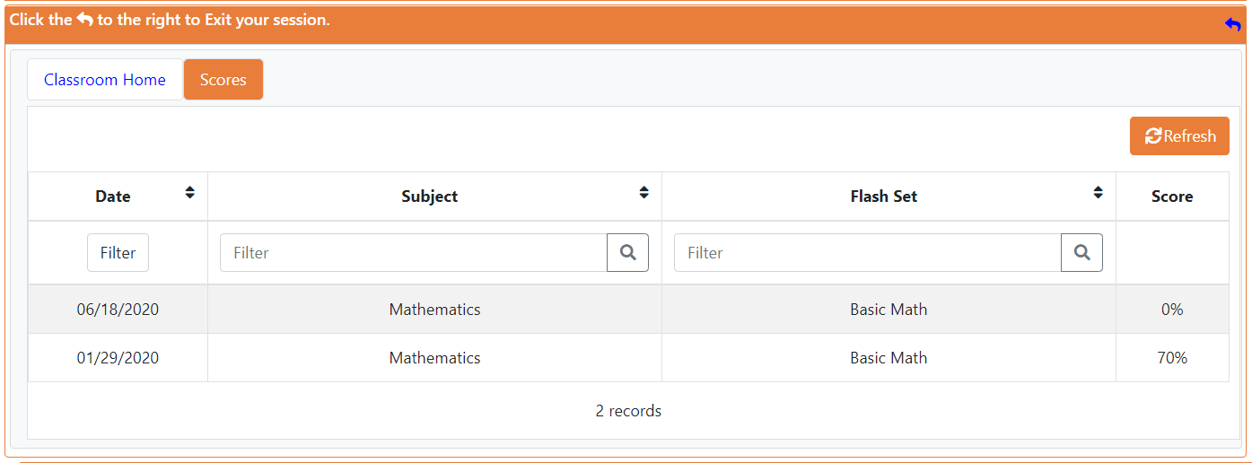
GED Flash Scores Tab
Notes:
The student can see a list of the sets they’ve completed and their scores. I have my students monitor their scores here or on an Aztec Checklist.

Slide 30
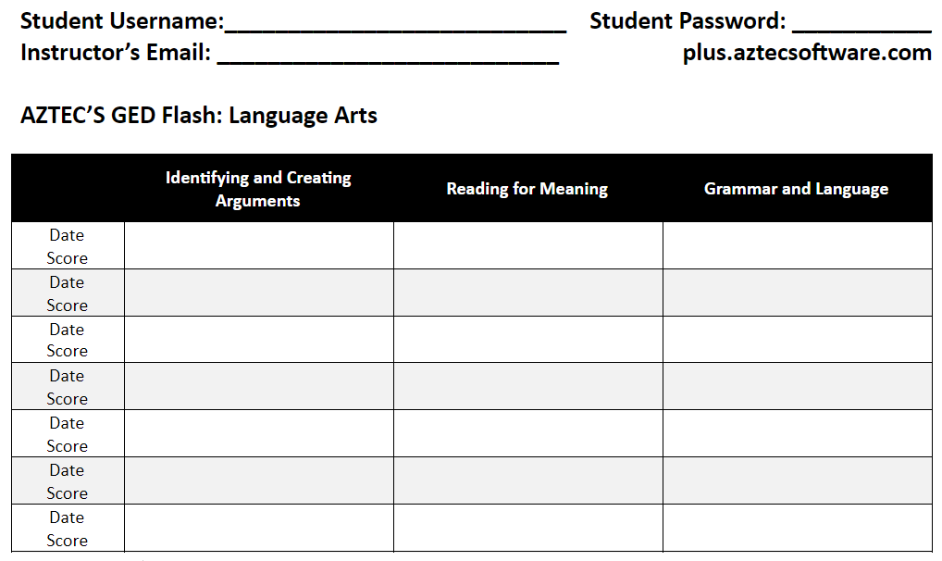
GED Flash Checklist
Notes:
The Checklists are available for each of the 4 Subject Area Flash Courses and you can see that there are columns for each of the Flash Sets. My students can input their scores in the checklist. For those who are in the 145 to 150 score group, they are supposed to notify me after they’ve finished 5 rounds of one set. Then we’ll review their scores and decide if they need to continue with these sets, move to another set, or if they need to stop working in Flash and look at reviewing some concepts or skills in the Aztec Learning Software classes.

Slide 31
The Administrator View of GED Flash
Notes:
Before we start reviewing the administrator view of GED Flash, are there any questions about the previous slides and what parameters are considered with student placement in the GED Flash program?

Slide 32
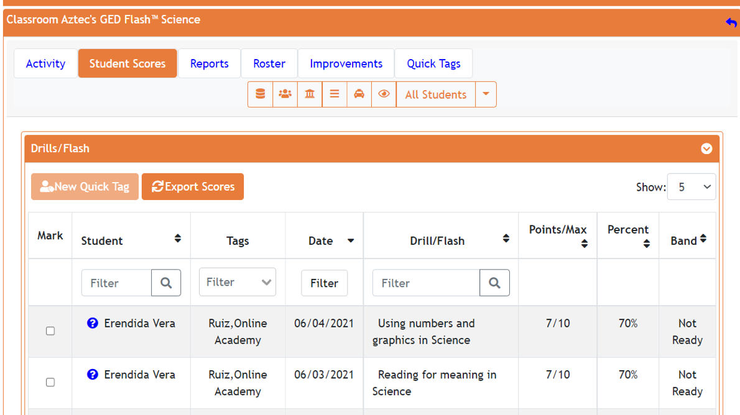
GED Flash: Student Scores
Sam Student
Sam Student
Notes:
On the Administrator’s side, you can click on Class Center and then click on the Flash Class that you’re looking for.
Next, you’ll click on Student Scores tab at the top of the page and then
search for your student in the student column. Your student’s name will appear multiple times
if they have completed multiple flash sets. You can see here that Sam Student has completed both
the Using Numbers and Graphics in Science and
also the Reading for meaning Flash Sets. You can click on the Question Mark next to a student’s name

Slide 33
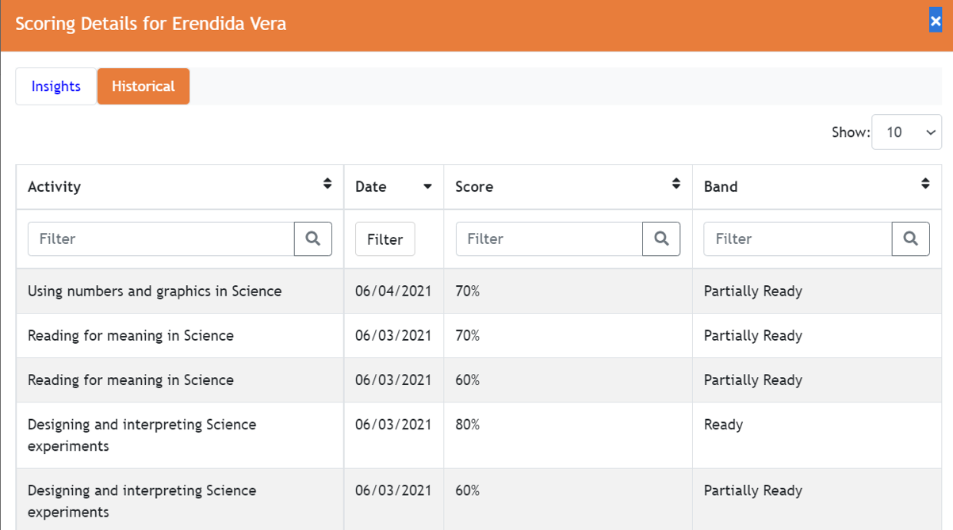
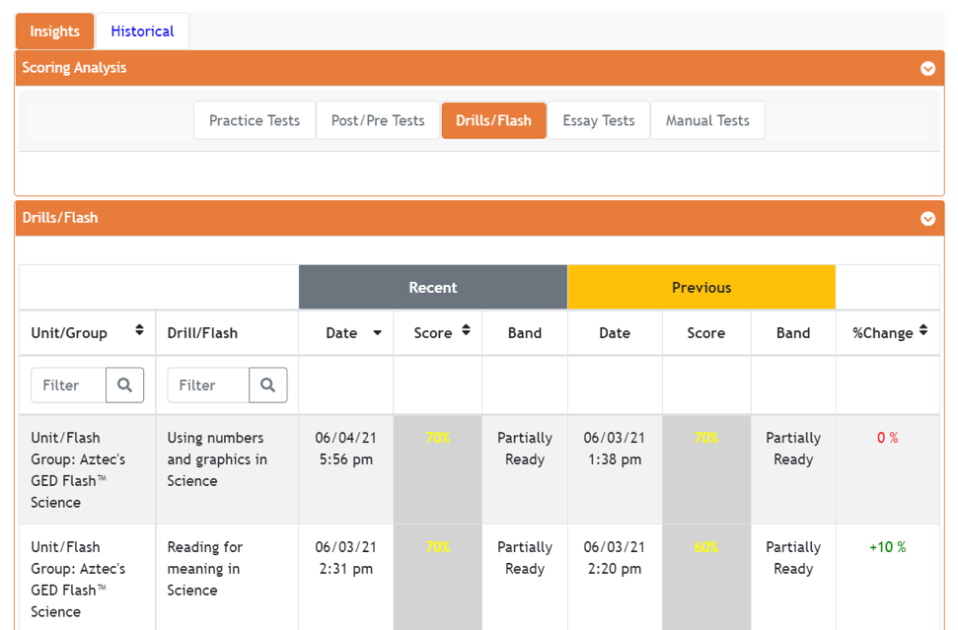
GED Flash: Student Scores
Sam Student
Notes:
to see a list of the student’s
most recent
and previous attempts at each flash set. To see a list of all your student’s attempts and scores, you can click on the Historical tab
For me, this is the most valuable format because my distance learning students may take multiple attempts of the Flash sets in between our class times together. This way I can see all of their work and evaluate their score patterns for either growth or learning needs.

Slide 34
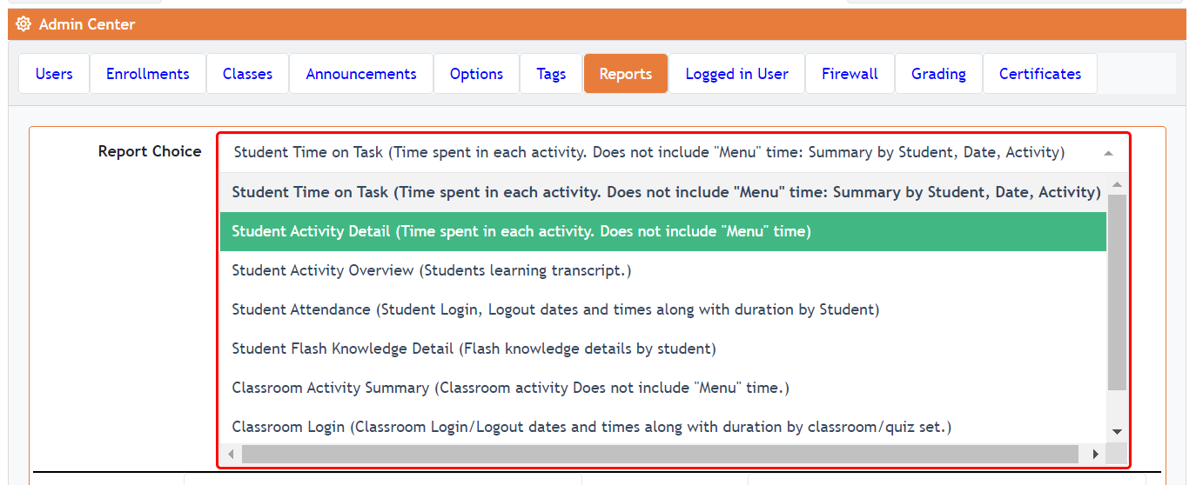
SCHOOL REPORTS
Notes:
You can also run the Student Activity Detail Report to review a student’s scores for each Flash Set attempt by
going to the Admin Center,
clicking on School Reports,
and then clicking on the Student Activity Detail Report

Slide 35
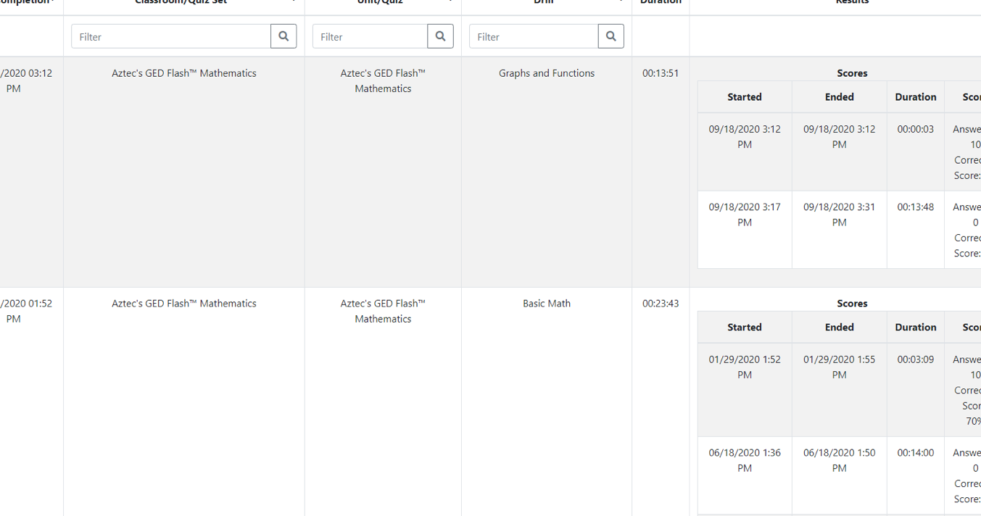
Student activity detail Report – Active DRILL/QUIZ time
Notes:
This portion of the Student Activity Detail report shows the student’s work on either the lesson drills or GED Flash. You can see by the GED Flash portion of the report that it also displays data for multiple attempts of the same drill or Flash set. This is a great way to monitor your students’ progress and see if their scores are increasing or if there needs to be some additional remediation based on consistent scores of 60% or lower.

Slide 36
Introducing
Aztec’s GED Play
Notes:
So we’re going to talk about GED Play next. Before moving on, do we have any questions about GED Flash?

Slide 37
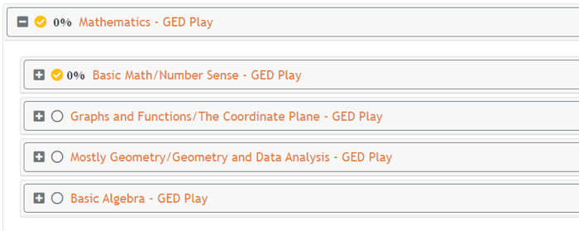
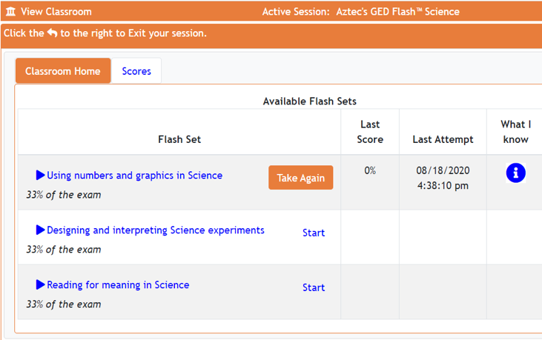
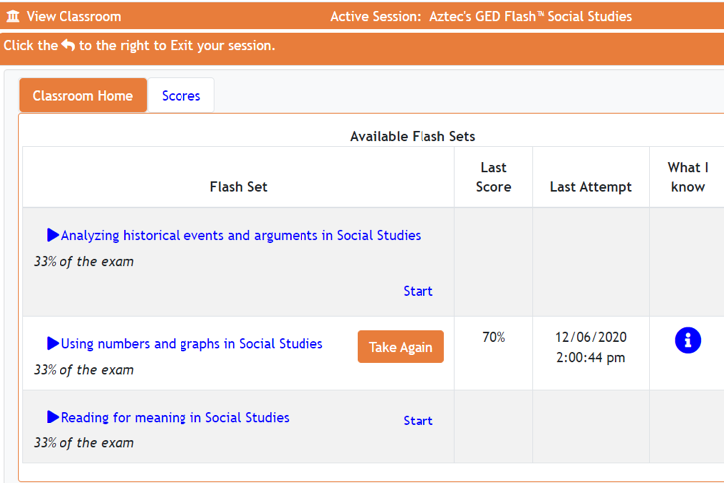
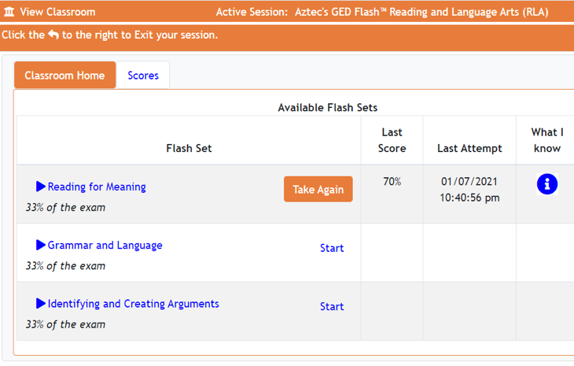
GED PLAY CLASSES
GED FLASH CLASSES
Notes:
There is 1 GED Play class for each of the 4 different GED Flash Classes. If you notice, they –
For the most part, each GED Play Class
Is set up with sets of videos
That are the same or very similar
To the Flash sets. Language arts has the most differently worded titles, but they match the flash sets.

Slide 38
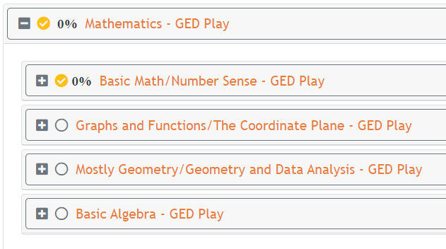
GED PLAY CLASSES
Notes:
I’m going to use the GED Play Math class as an example. If I click on The first set, Basic Math and Number sense

Slide 39
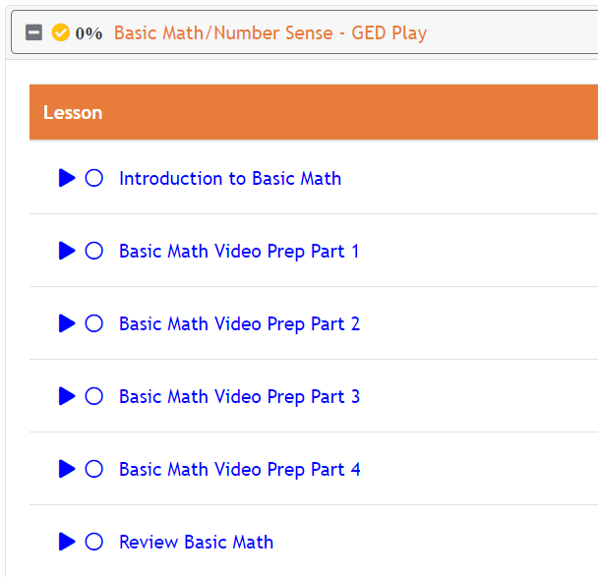
GED PLAY CLASSES
Notes:
You can see that this Play Set is broken down into an Intro Video, a Review video, and then 4 prep videos. Each video is anywhere between 10 and 20 minutes long.

Slide 40
GED PLAY CLASSES
Notes:
The Prep videos have 3 slides- an intro, the slide with the video, and then the closing. This is the intro slide.
It’s important for the instructor to go through the intro slides to become familiar with what topics and skills each video will cover. In many versions of Play, the videos have titles with all the topics covered.

Slide 41
GED PLAY CLASSES
Notes:
I’m going to pause here to show just a short example of a video from GED Play for mathematics. This is an excerpt from Basic Algebra Video #1 entitled “Translating English into Math” As you can see here, the materials are covered with a tutor and presented with clearly stated definitions and examples.

Slide 42
Review and Final Notes
Notes:
We’ve covered a lot and I just want to go through an abridged version in the next few slides. Before doing so, are there any questions about what we just covered?

Slide 43
GED Flash with students
Placement in a GED class based on CASAS Reading GOALS scores
GED Ready Practice test (Social Studies or Math)
145 or lower – GED Lessons with Aztec Software or textbooks
150+ – GED Flash (and GED Play, as needed)
145-150 – GED Flash or Aztec lessons
Complete 5 sub-Set rounds. Review the Knowledge Report.
Review skills with the instructor
Remediation with Aztec lessons
5 more sub-Set rounds
Complete 5 sub-Set rounds. Review the Knowledge Report.
80% Rule
Notes:
So let’s review what we’ve gone over so far in regards to my students working on GED Flash.
My student are placed in my GED class based on their scores on a CASAS Reading GOALS test. They must score in the 9th grade reading level or a 239 to be in my GED class.
After they are placed in my GED class, they need to take an official GED Ready Practice Test and it’s usually Social Studies or Math.
Students who score 145 or lower are placed either in Aztec Learning Software Classes or given textbook materials to work with.
If their score is 150 or higher, we place them in GED Flash to practice until they can take the GED test. These students are allowed to complete as many or as few of the Flash sets before they schedule to test. They have already earned a Practice test score that is 5 points or more higher than the required passing test score of 145. If they are struggling with GED Flash and have already completed Aztec GED Lessons or feel like they need just a review of the concepts covered in the GED Flash Cards, you can enroll them in GED Play to review the sections.
If their score is between 145 and 150, the student works either on GED Flash or Aztec lessons, usually depending on what the student feels most comfortable with.
If students decide to start with the GED Flash sets, they would complete 5 rounds in one subset. I would then review their Knowledge Report them to determine what skills need some additional work.
I need to determine if the student should review the concepts with me,
move to Aztec for remediation,
or just complete more sets to see if the student can improve their scores.
This is the part we haven’t discussed yet, but after 5 sub-Sets are completed, the student and I will review the Knowledge Report again and look at their total score for the 10 completed sets.
The rule in our class is 80% - They need to have a score of 80% after 5 sub-Sets before they move to a new sub-Set.

Slide 44
GED PLAY With Students
Direct Instruction
Before Instruction – Anticipatory Set (in class or as homework)
After Direct Instruction – Post-Instruction review (in class or as homework)
Remote Instruction
Anticipatory Set
Post-Instruction
Gap Filler
Review
Refresh
Notes:
GED Play can be integrated throughout a students’ instruction
It can be included with direct instruction either before or after the lessons, either whole class or as homework.
With remote instruction, either synchronous or asynchronous, Play videos can also be utilized in multiple instructional strategies to introduce, support, or review skills and concepts.

Slide 45
What is Aztec’s 80% rule?
Students must earn 80% or higher on any post-assessment before moving forward to the next activity.
Notes:
On a side note, I spoke a lot about Aztec’s 80% rule? This is a best instructional strategy that asks students to earn a score of 80% or higher on any drills, Flash sub-sets, or post-tests before moving forward to the next activity. The 80% rule, combined with Aztec’s formative assessments, ensures that a student is proficient on core competencies before continuing down their learning paths. In simpler terms, as a student once explained it back to me – “So I should probably score at least an 80% since a B grade is better than a C, right?”

Slide 46
GED Flash with students – after 5 rounds
After 5 Rounds?
Move to the next sub-Set (80%+)
Review the GED Play Videos and try another set of 5 rounds (60%-80%)
Move to Aztec Learning Software (under 60%)
Notes:
As stated before, I review the student’s Knowledge Report with them after they’ve completed 5 rounds of a Flash Subset. After those 5 rounds
The student is allowed to move to a new sub-set if their core is 80% or higher
Or the student can review the GED Play videos and then do another 5 rounds if their score is between 60 and 80 percent.
If their score is 60% or lower,
we’ll look at their Knowledge Report to determine what skills the student needs to work on. If you look at my scores, you can see that there are three different areas that I need to focus on
This 1st area is determining if a numerical expression is undefined. This is a pretty straightforward skill. A numerical expression is undefined if there is no answer or if, in fraction form, the denominator is 0. This skill doesn’t require a lot of practice to master. Most often, it’s using a given set of values for x that are used to solve a given expression so that the denominator is 0. Usually, a student who has a preliminary understanding of substitution can solve this problem.
The next two skills cover a broader skillset since the student needs to be able to solve multistep, real world measurement problems that use ratios, proportions
and multistep, real world percentage problems that include interest, taxes, tips, and commissions as well as the increase and decrease of prices and percentages. This covers an array of skills, formulas, and procedures. If a student struggled with broad, multi-skill areas like this, I would have the students complete the corresponding Lessons and Drills from the Aztec Learning Software Suite to review these concepts before returning back to GED Flash to complete 5 more sub-sets.

Slide 47
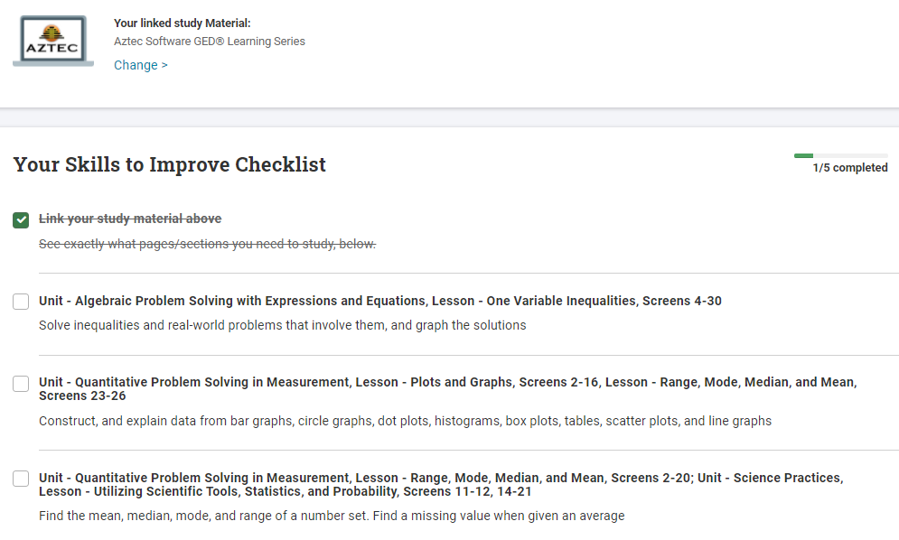
GED Flash after Reviewing
the GED Ready Score Report
Notes:
On a final note, it is important to review the content of the GED Ready Score Reports. In most instances, students scores will identify needed remediation covered in all of the Flash Sets. However, if you do have a student whose report identifies skills not covered in a skill set, it would be the instructor’s choice to either assign all of the skill sets or just those where the skill remediation is necessary. As shown by this score report, the student only needs to remediation in working with inequalities and graphing their solutions, working with different graphs and plots, and working with number sets to find the mean, median, mode, and range.

Slide 48
GED Flash after Reviewing the GED Ready Score Report
Notes:
In this case, the instructor could have the student just complete Flash sets in the
Graphs and Functions set and the
Basic Algebra set. However, the instructor may also choose to have the student complete all of the sets so that he or she has practice completing questions in all of the different areas before taking the official GED test.

Slide 49
GED Flash after Reviewing the GED Ready Score Report
Notes:
Based on these three areas of identified remediation, instructors might want to just assign some practice in these three areas and skipping GED Flash entirely. However, I really have come to rely on GED Flash to not only prepare my students with the skills that they need to pass the GED tests but also with practice for them to experience the GED Questions. By Using GED Flash, my students practice dragging and dropping questions into given columns and or rows. In fact, this is a skill that my students who are working on tablets have struggled with repeatedly. One of the most current conversation I’ve had with a handful of my students in the GED Online testing procedures. I’ve had a few students choose to test at home using the Online testing procedures. I’ve used GED Flash to help them get used to using the embedded calculator and we’ve figured out how to simulate the embedded whiteboard so they can practice writing out their scratch paperwork with their computer mouse. For me and my students, GED Flash has become a valuable tool that allows them opportunities to not only assesses readiness to take the official GED tests but also to practice the techniccal skills needed to successfully complete a test.

Slide 50
What we know
Notes:
Key Points

Slide 51
Data Shows: Higher Likelihood of Passing
GED Flash Group | # of Students | Mean GED® Ready Math Test Score | Mean GED® Math Test Score
Low Users (22 questions or less) | 8,304 | 146 | 146
High Users (91+ questions) | 8,406 | 152 | 150
Students who practiced frequently with GED Flash scored on average four points higher on their GED test vs. those who rarely used it.

Slide 52
Data Shows: More Practice Means More Correct Answers
GED Flash Group | Mean Percent Correct
Low users (22 or fewer) | 43.9%
High users (91 or more) | 53.2%
The more students practiced, the more questions they got correct.
Superusers of Flash (340+ questions) answered 90% of questions correctly.
More correct answers also means higher confidence: 79% of GED Flash users agreed that they felt more confident about taking the GED test after using GED Flash.

Slide 53
Final Questions
Email: Support@AztecSoftware.com
Notes:
Please don’t hesitate to reach out to support at Aztec software dot com with any of your questions. On behalf of Aztec Software, I thank you so much for allowing me to participate in your meeting and I look forward to working with you at future professional development events.

Slide 54
Thank you!
Communicate with GED Testing Service® help@ged.com
GED Testing Service – Debi.Faucette@ged.com
Aztec – Support@AztecSoftware.com

